Slide 1


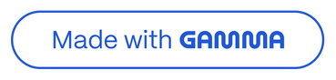
Start Your AI Agency: No Code, No PhD Needed!
Feeling stuck by tech? AutoBoss is the world's first AI Agency Starter Kit designed for you, the aspiring solopreneur, to easily build and sell AI solutions.
by Techiral

Slide 2
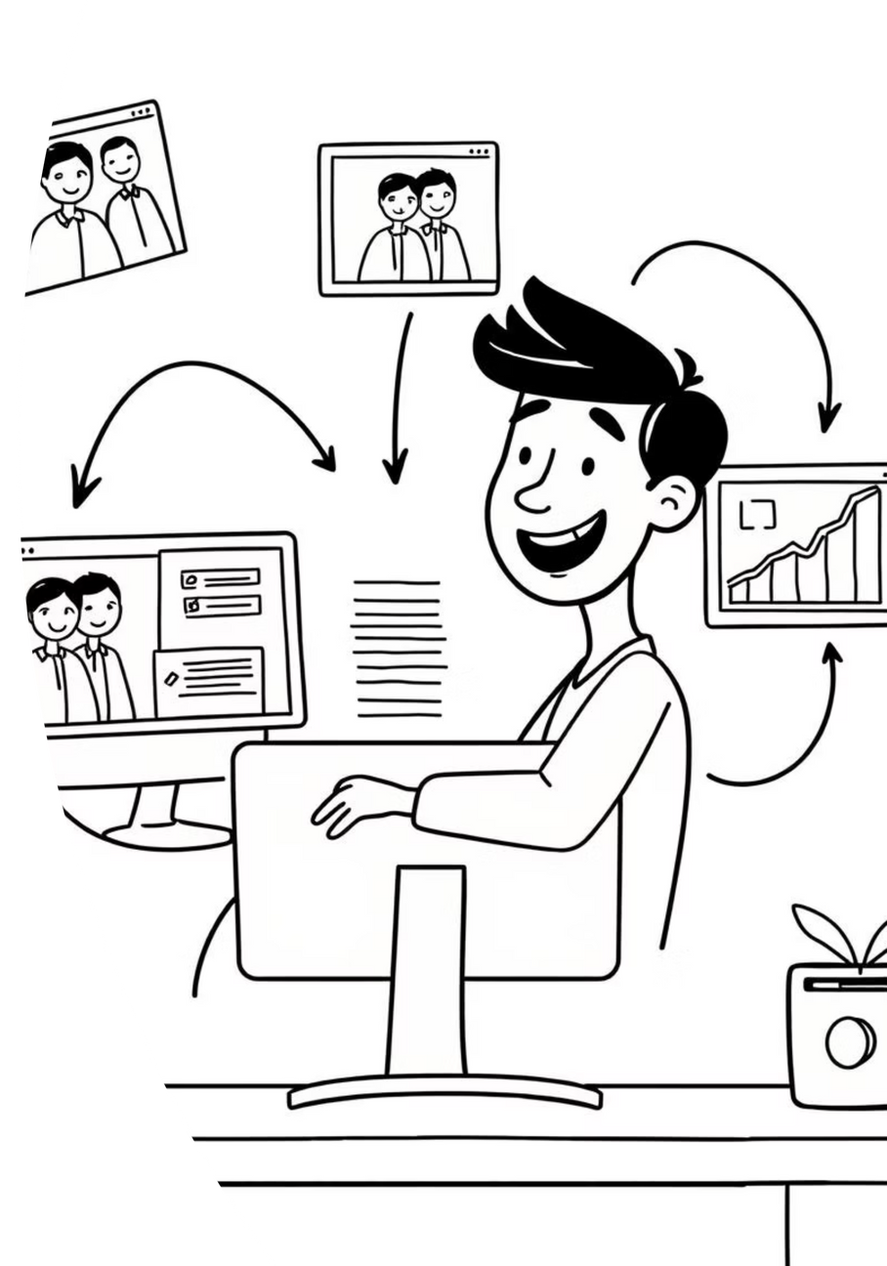
Why AutoBoss is Your Go-To for AI Agencies
No Coding. Really.
Client-Focused Results
AutoBoss handles the complex AI tech, so you can focus on client relationships and delivering value.
Create AI tools that genuinely help businesses save time, find more leads, and enhance services.
Fast-Track Your Agency
We provide a clear, simple path to offering AI services, bypassing the usual headaches and learning curves.

Slide 3





Your Complete Toolkit for AI Success
Client Workspaces
Organize each client's AI employees, training data, and settings in their dedicated private space.
Hire Your AI Employee
Build AI for specific roles: website chat, phone calls, or a blend of services, all in one platform.
Simple 'On-the-Job' Training
Train AI using your client's own documents (FAQs, service lists) or website content.
Easy Deployment
Deploy AI employees swiftly with simple embed codes or direct links. No technical complications.

Slide 4

Your 3-Step Plan to Your First AI Client
1. Add a Client Project
Create a dedicated space for your client in AutoBoss, gathering their basic business info and desired AI task.
2. Hire & Train Their AI
Choose an AI job (e.g., 'Answer Website Questions'), define its personality, and input client-specific information.
3. Deploy & Get Paid!
Launch the AI employee for your client, offer ongoing support, showcase results, and expand your agency.

Slide 5
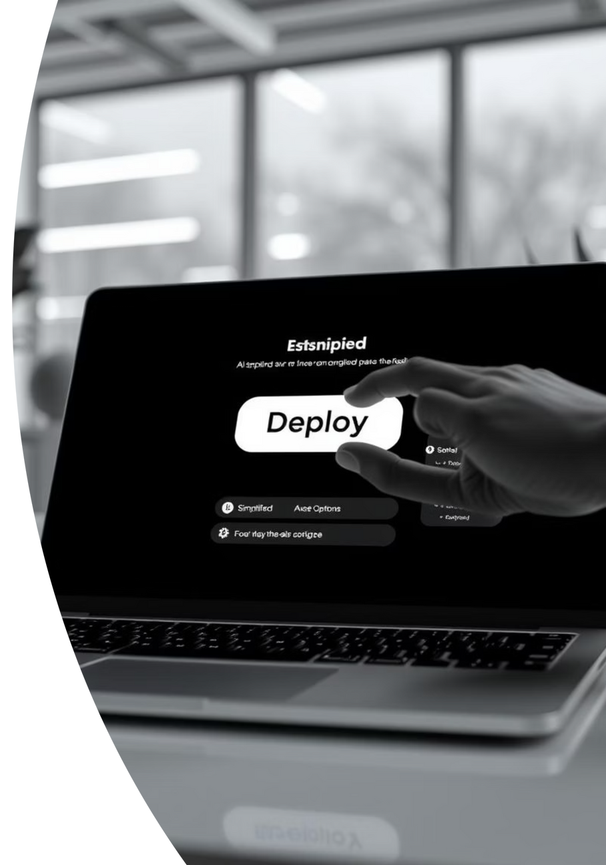
Witness the Simplicity: Quick Demo
See how fast you can hire and train an AI employee for a client using AutoBoss. No technical skills required!
Watch for a demo coming soon: Your First AI Employee in Under 5 Mins!

Slide 6


Success Stories: Real People, Real AI Agencies
Maria K., Bakery Client's Friend
James P., New AI Agency Owner
"Helped a friend set up an FAQ bot for her bakery using AutoBoss. Much easier than I thought, and she's thrilled! Finally, something that makes AI simple for everyday businesses."
"Wanted to offer AI services but was overwhelmed. AutoBoss's 'World's First Starter Kit' claim is legit – it gave me a clear path to my first paying client."

Slide 7

Be a Founding Member: Free Early Access
AutoBoss is currently free. We're seeking founding users to help us refine the ultimate AI agency kit. Your feedback is invaluable as we build together.
This is your chance to gain early access and establish your agency with zero platform costs. Future access will be paid.

Slide 8


Ready to Launch Your No-Code AI Agency?
AI is the future of business efficiency. AutoBoss empowers you to offer cutting-edge AI solutions, even if you're just starting your entrepreneurial journey.
No credit card needed for early access. Start building today!

